Slide 1
John “Scooter” Morris
Nadezhda T. Doncheva
October 3, 2015
EMBO Practical Course
TGAC, Norwich, UK
Notes:
EDIT: Presenter list and workshop information

Slide 2
Outline
Biological Networks
Why Networks?
Biological Network Taxonomy
Analytical Approaches
Visualization
Coffee Break
Introduction to Cytoscape
Hands on Tutorial
Data import
Layout and apps
Lunch Break
Hands on: Using Cytoscape to explore YOUR data
Notes:
EDIT: schedule

Slide 3
Introductions
John “Scooter” Morris
2010-Current
Adjunct Assistant Professor, Pharmaceutical Chemistry
2004-Current
Director, NCRR Resource for Biocomputing, Visualization, and Informatics (RBVI) @ UCSF
1985-2004
Principal Systems Architect: Genentech, Inc.
Cytoscape core team since 2006
Author of several Cytoscape plugins
SFLDLoader, structureViz, clusterMaker, chemViz, metanodePlugin, groupTool, commandTool, bioCycPlugin
Notes:
EDIT: introductions per presenter

Slide 4
Introductions
Nadezhda T. Doncheva
2010-current:
Research scientist at the Max Planck Institute for Informatics under the supervision of Mario Albrecht
Author or co-developer of several Cytoscape plugins:
RINalyzer, structureViz2, setsApp, NetworkAnalyzer, NetworkPrioritizer

Slide 5
Introductions
Alex Pico, Ph.D.
2010-Current
Executive Director, National Resource for Network Biology
2007-Current
Bioinformatics Group Leader, Gladstone Institutes, UCSF
Cytoscape core team since 2007
Developer of several Cytoscape plugins:
CriteriaMapper, GenMAPP Workspaces, GO-Elite, GOLayout, BubbleRouter, Mosaic.
Notes:
EDIT: introductions per presenter

Slide 6
Introductions
You?
Clinician
Biologist
Bioinformatician
Computer Scientist
Chemist
Other?

Slide 7
Installation
If you haven’t already, please install:
Cytoscape 3.2.1
Apps:
clusterMaker, chemViz, cyAnimator
Notes:
EDIT: Update per provisions

Slide 8
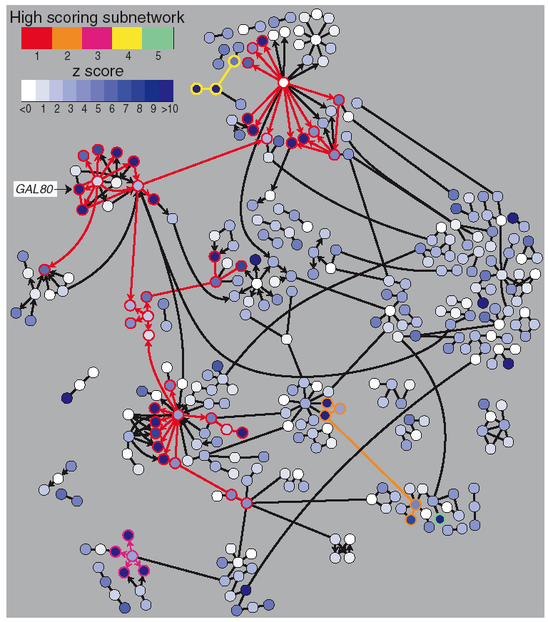
Why Networks?
Networks are…
Commonly understood
Structured to reduce complexity
More efficient than tables
Network tools allow…
Analysis
Characterize network properties
Identify hubs and subnets
Classify, quantify and correlate, e.g.,
cluster nodes by associated data
Visualization
Explore data overlays
Interpret mechanisms, e.g., how a process
is modulated or attenuated by a stimulus

Slide 9
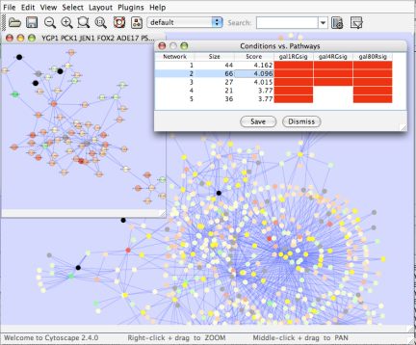
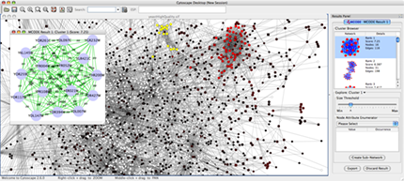
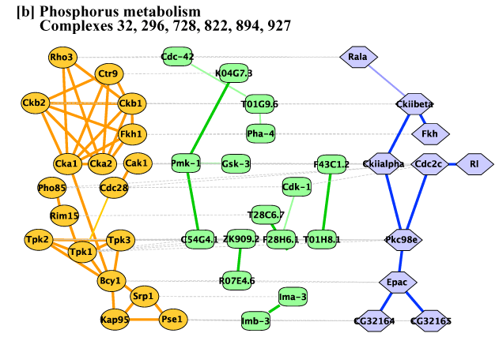
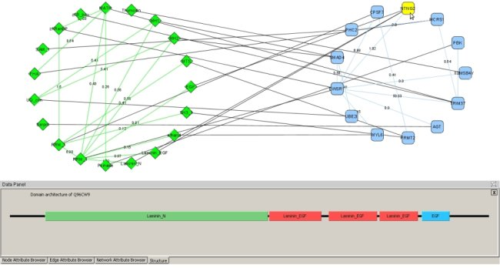
Applications of Network Biology
Gene Function Prediction shows connections to sets of genes/proteins involved in same biological process
Detection of protein complexes/subnetworks discover modularity & higher order organization (motifs, feedback loops)
Network evolution biological process(s) conservation across species
Prediction of interactions & functional associations statistically significant domain-domain correlations in protein interaction network to predict protein-protein or genetic interaction
mCode, University of Toronto
jActiveModules, UCSD
PathBlast, UCSD
DomainGraph, Max Planck Institute
Notes:
Gene Function Prediction – basic but important, examining genes (proteins) in a network context shows connections to sets of genes/proteins involved in same biological process that are likely to function in that process
Detection of protein complexes/other modular structures – although interaction networks are based on pair-wise interactions, there is clear evidence for modularity & higher order organization (motifs, feedback loops)
Network evolution – biological process(s) conservation across species (PathBLAST, NetworkBLAST to align p-p interaction networks & clusters)
Prediction of new interactions and functional associations – Statistically significant domain-domain correlations in protein interaction network suggest that certain domain (and domain pairs) mediate protein binding. Machine learning extends this to suggest to predict protein-protein or genetic interaction through integration of diverse types of evidence for interaction

Slide 10
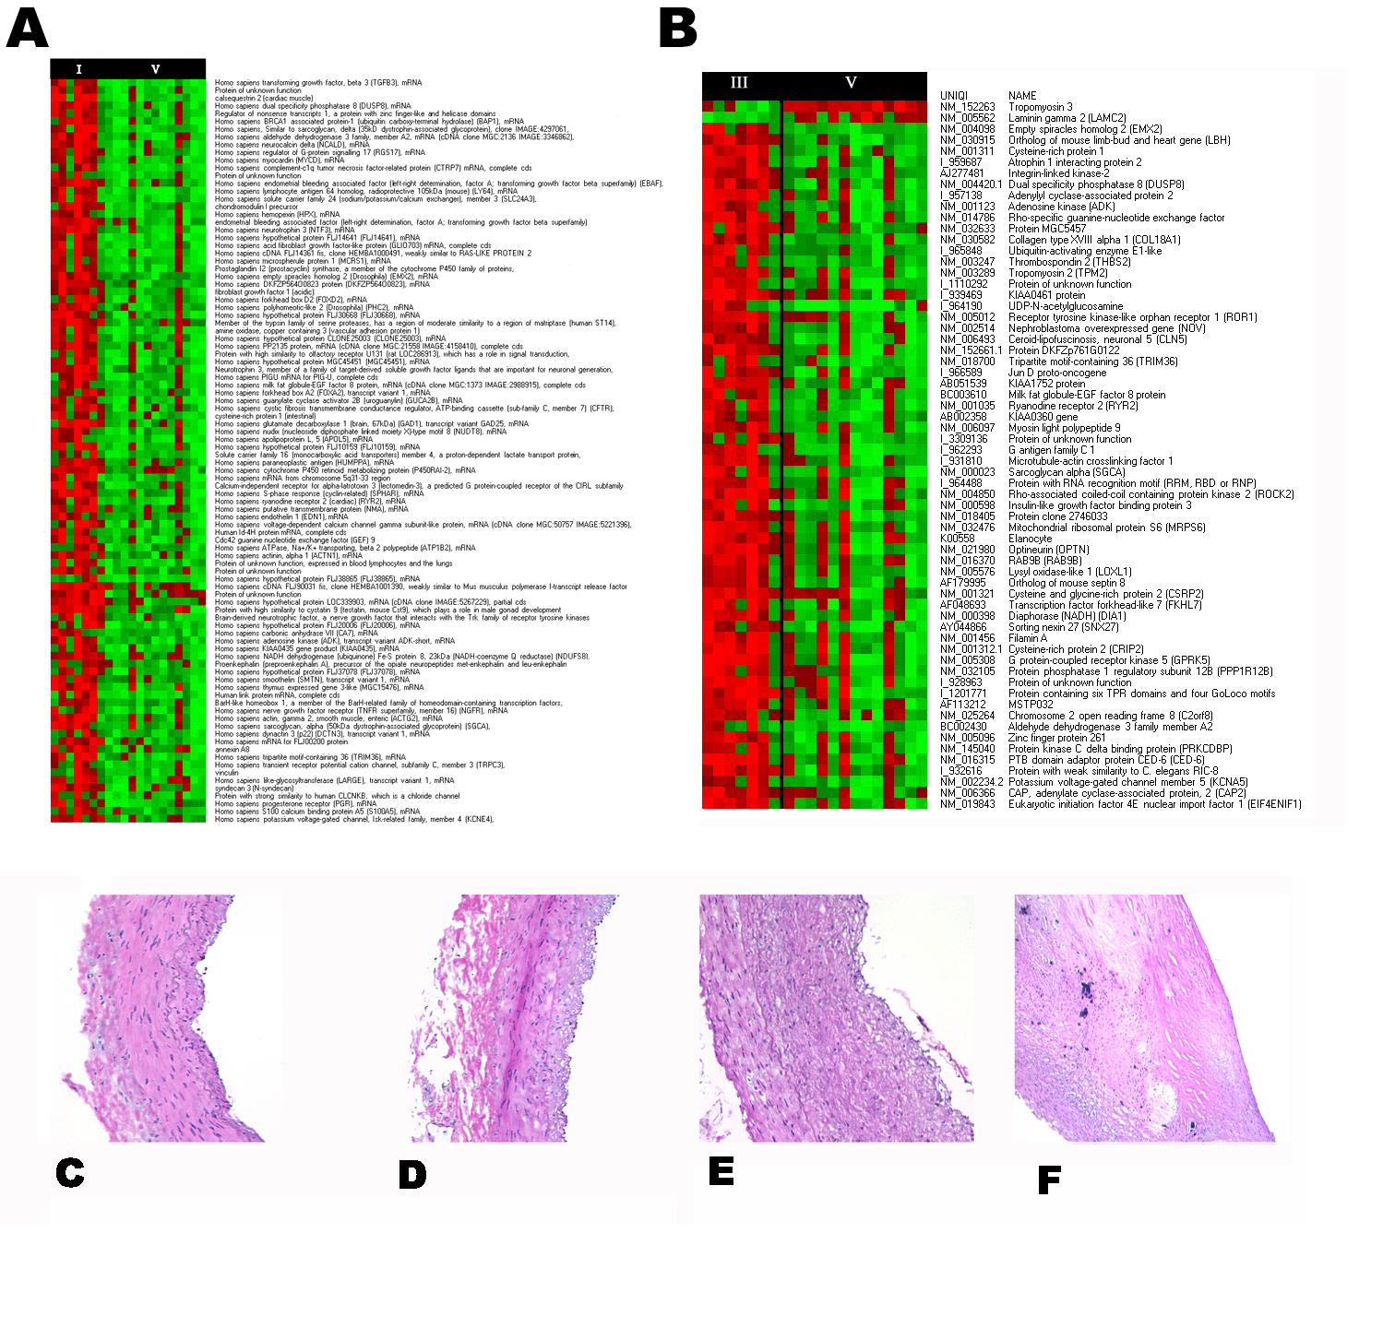
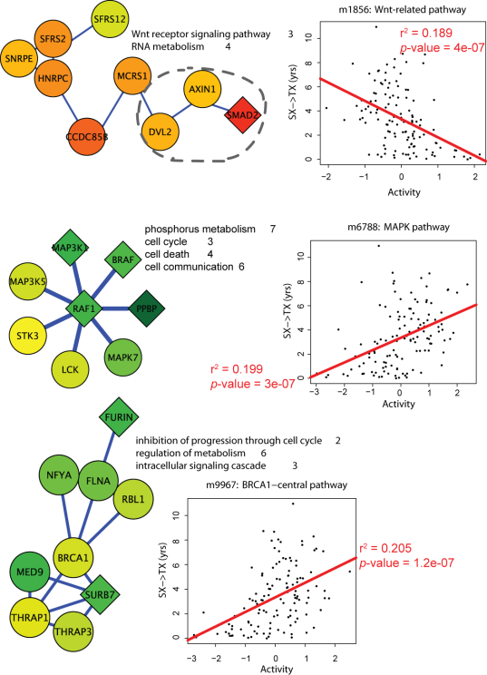
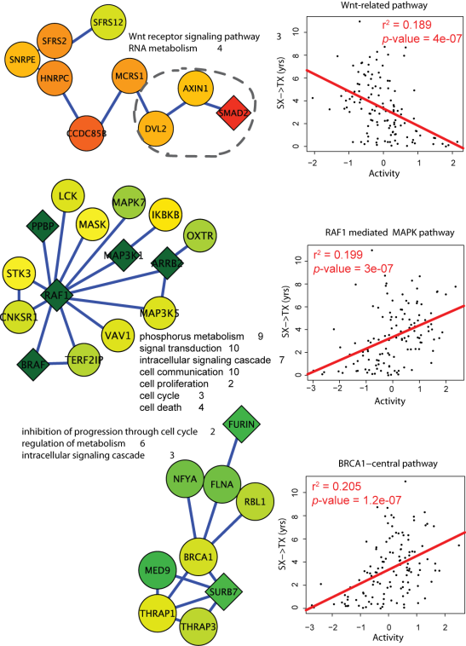
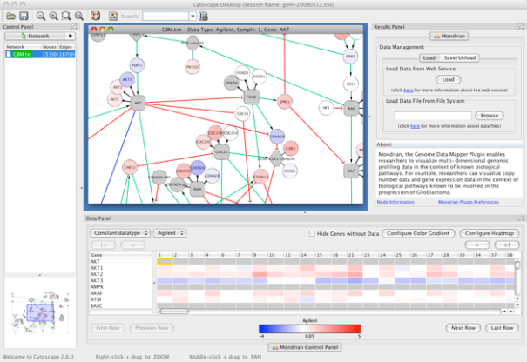
Applications in Disease
Identification of disease subnetworks – identification of disease network subnetworks that are transcriptionally active in disease.
Subnetwork-based diagnosis – source of biomarkers for disease classification, identify interconnected genes whose aggregate expression levels are predictive of disease state
Subnetwork-based gene association – map common pathway mechanisms affected by collection of genotypes (SNP, CNV)
Agilent Literature Search
PinnacleZ, UCSD
Mondrian, MSKCC
Notes:
Identification of disease subnetworks – identification of disease network subnetworks that are transcriptionally active in disease. These suggest key pathway components in disease progression and provide leads for further study and potential therapeutic targets
Subnetwork-based diagnosis – subnetworks also provide a rich source of biomarkers for disease classification, based on mRNA profiling integrated with protein networks to identify subnetwork biomarkers (interconnected genes whose aggregate expression levels are predictive of disease state)
Subnetwork-based gene association – molecular networks will provide a powerful framework for mapping common pathway mechanisms affected by collection of genotypes (SNP, CNV)

Slide 11
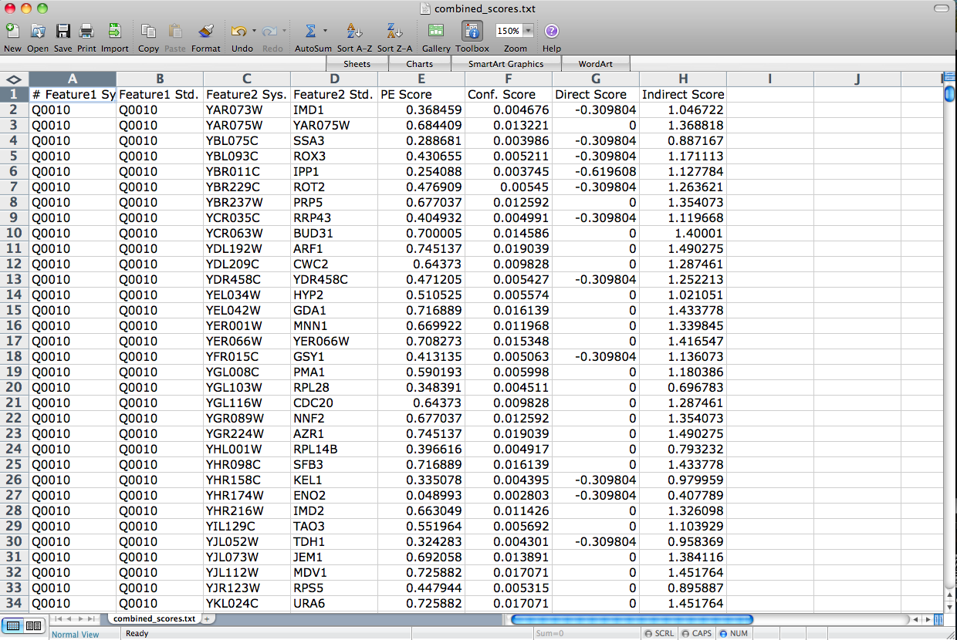
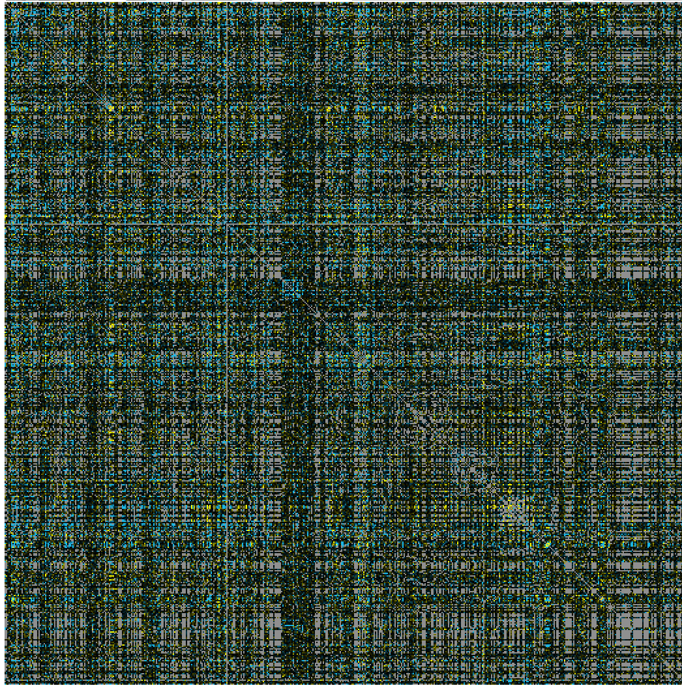
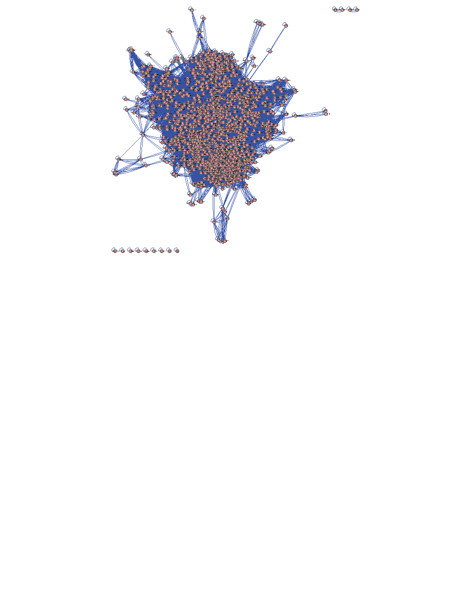
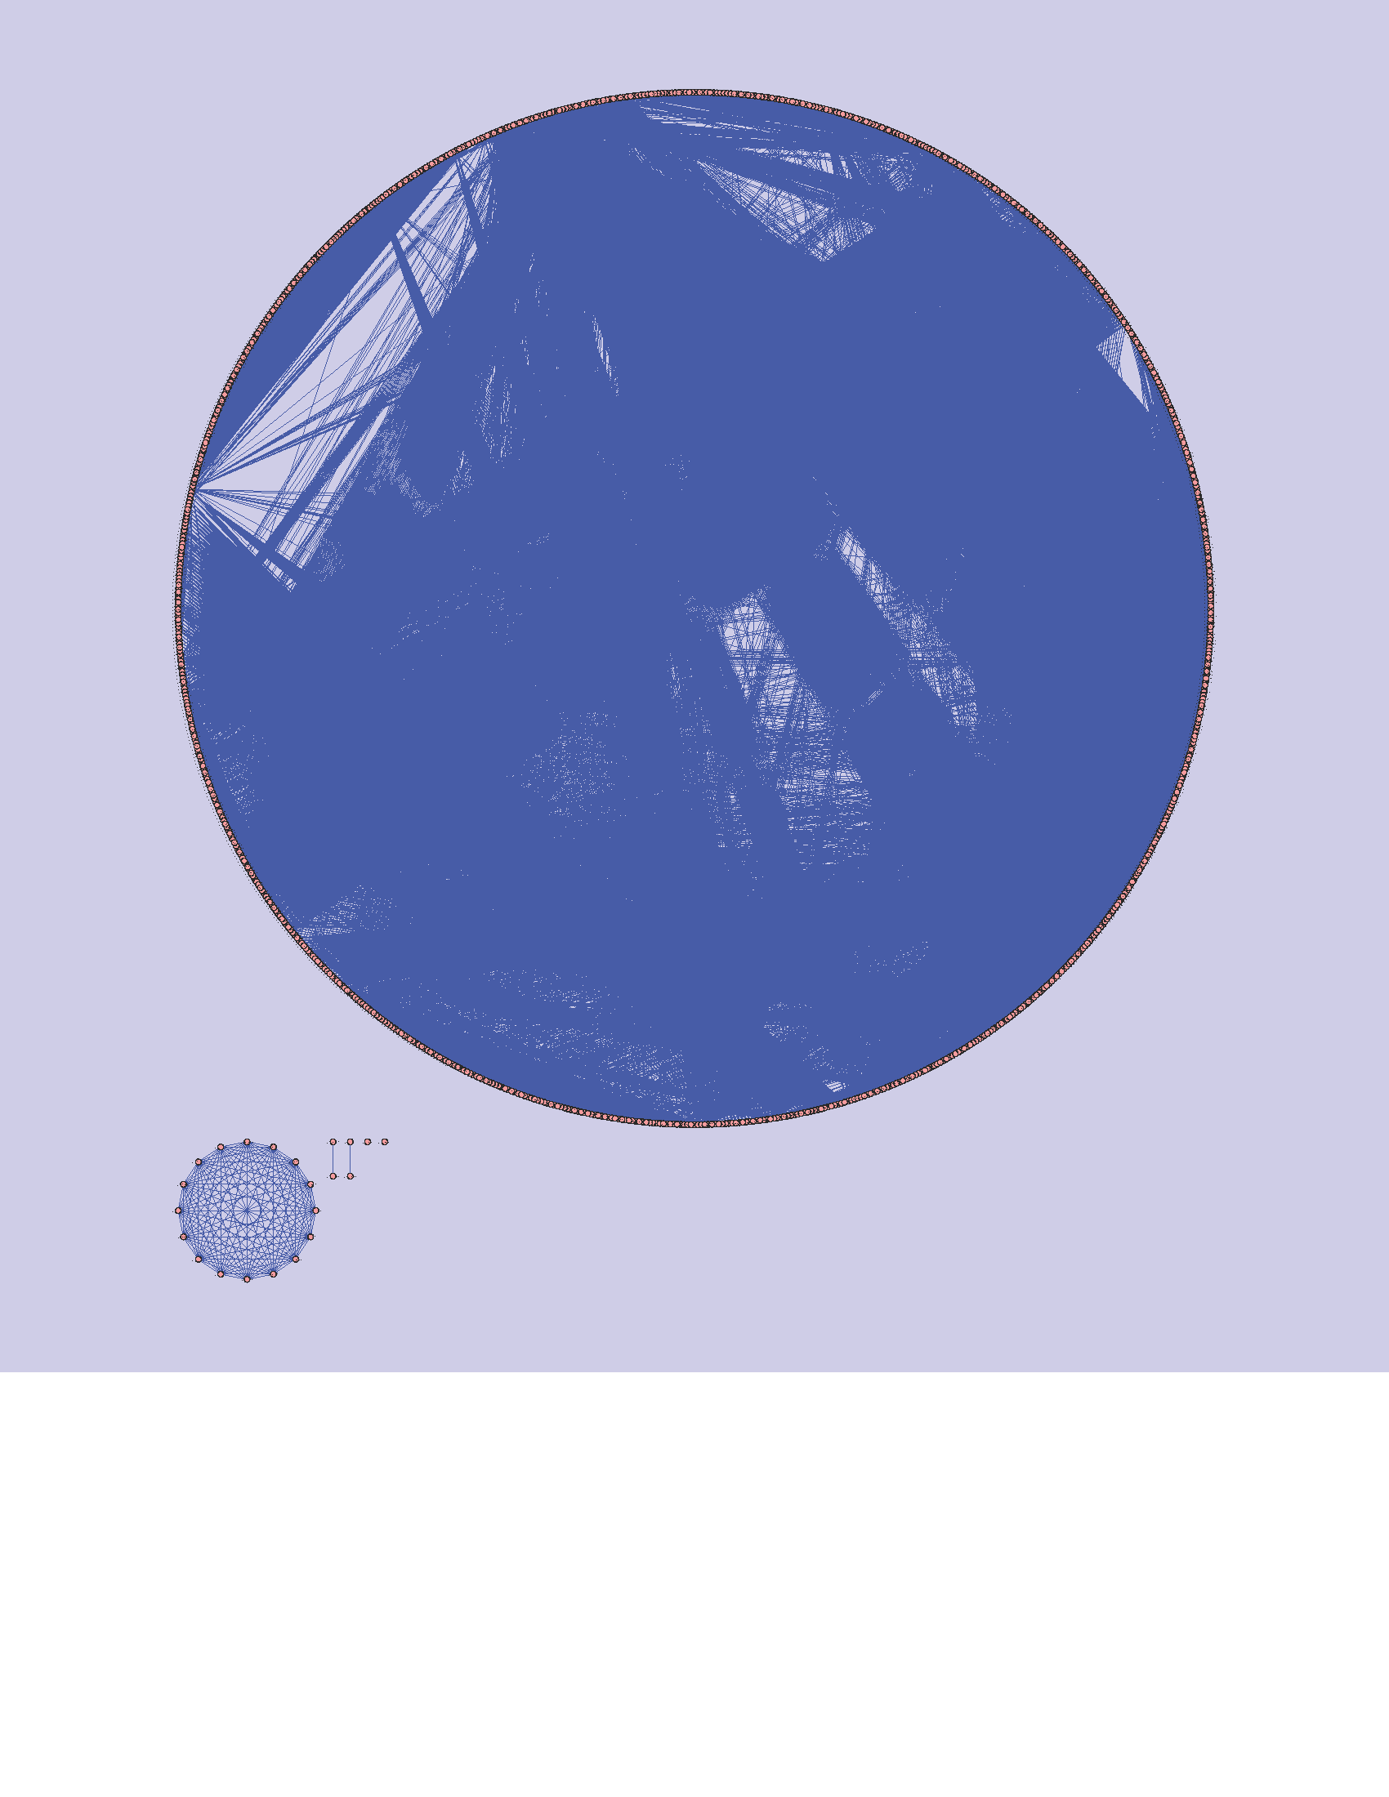
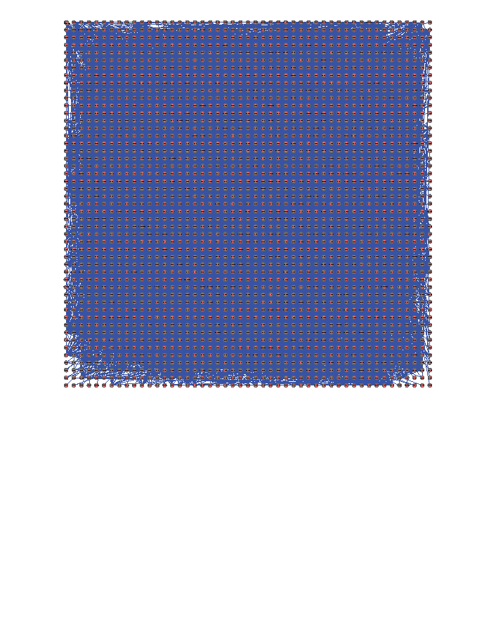
The Challenge
Making sense out of biological networks….

Slide 12
The Challenge
Biological networks
Seldom tell us anything by themselves
Analysis involves:
Understanding the characteristics of the network
Modularity
Comparison with other networks (i.e., random networks)
Visualization involves:
Placing nodes in a meaningful way (layouts)
Mapping biologically relevant data to the network
Node size, node color, edge weights, etc
…which then allowing for more analysis!

Slide 13
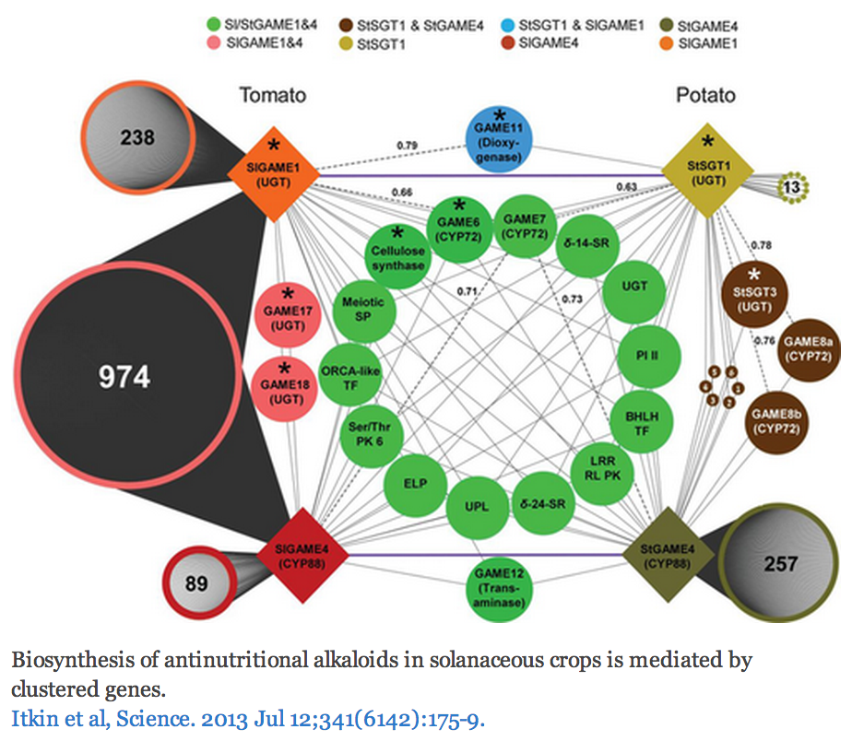
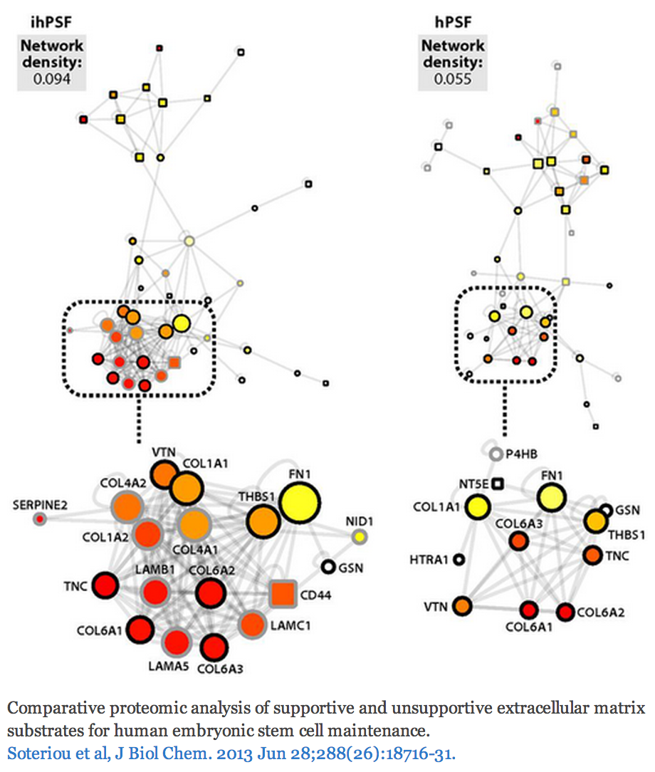
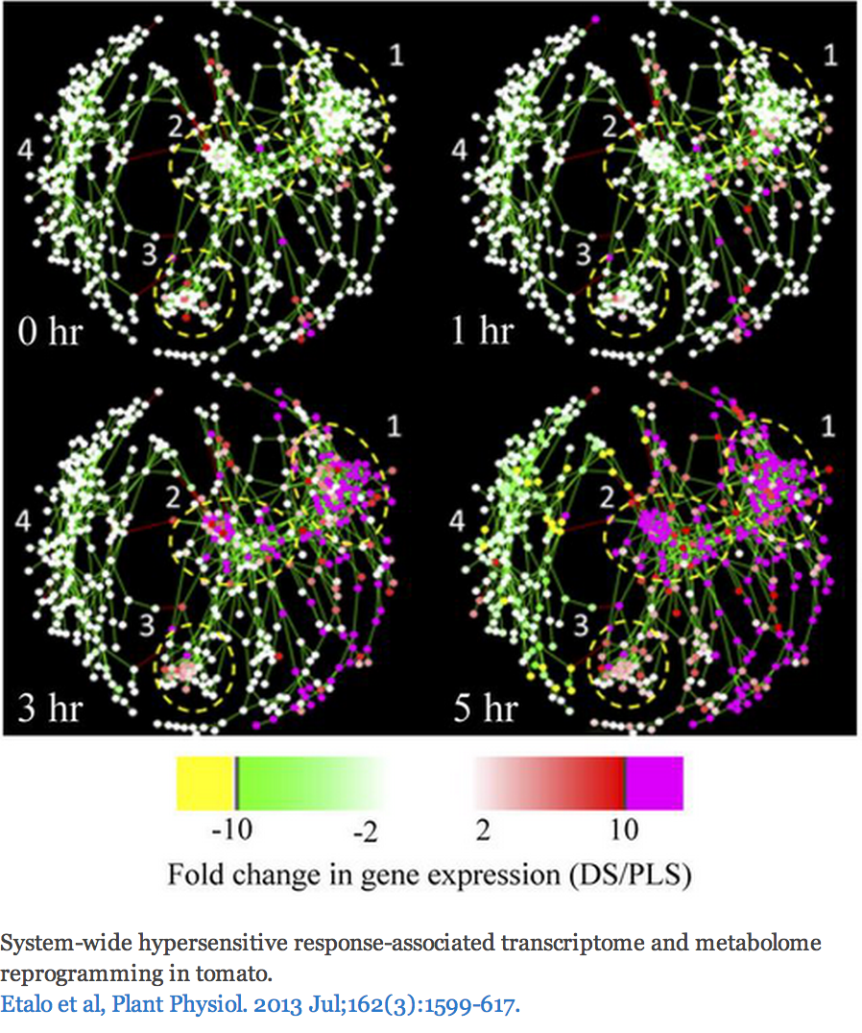
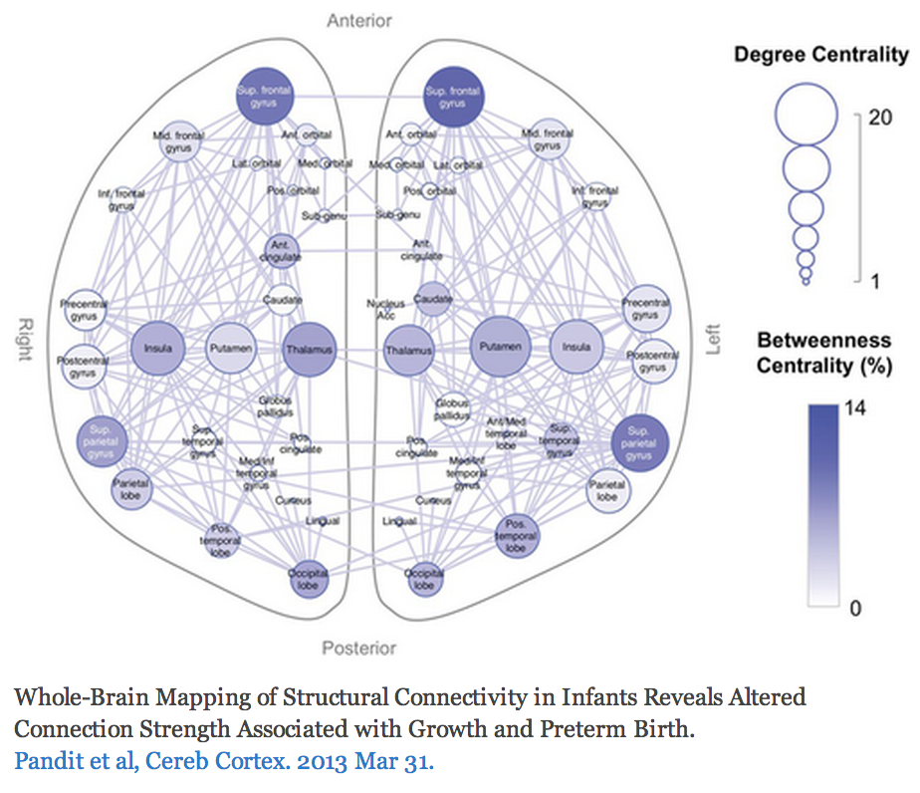
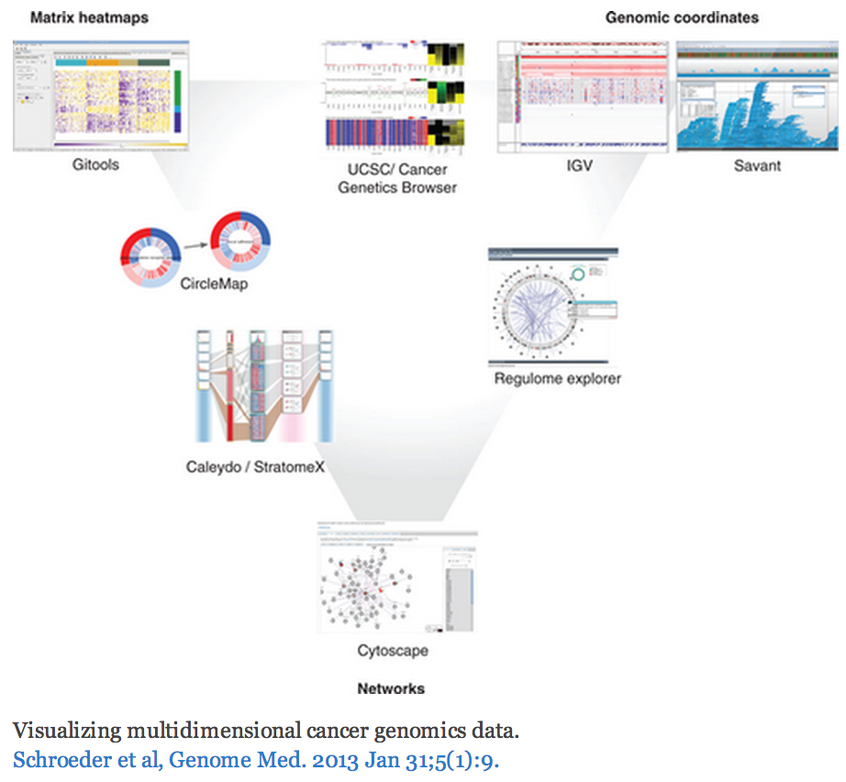
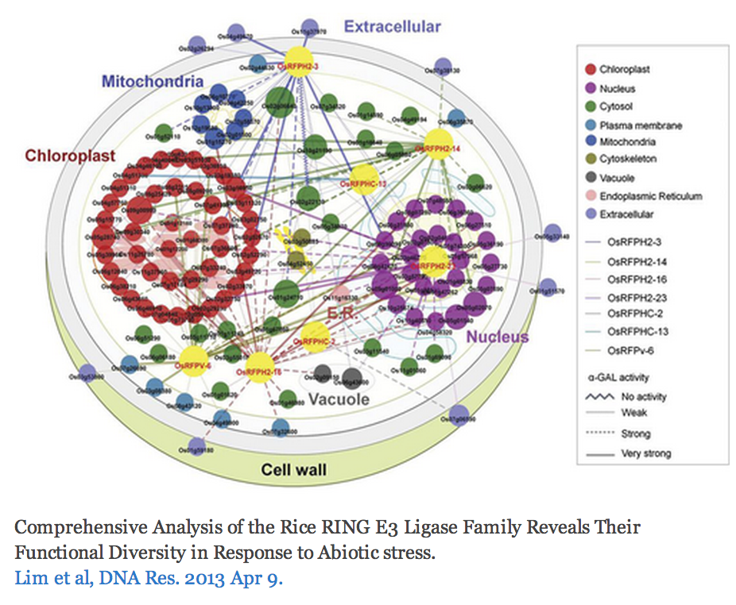
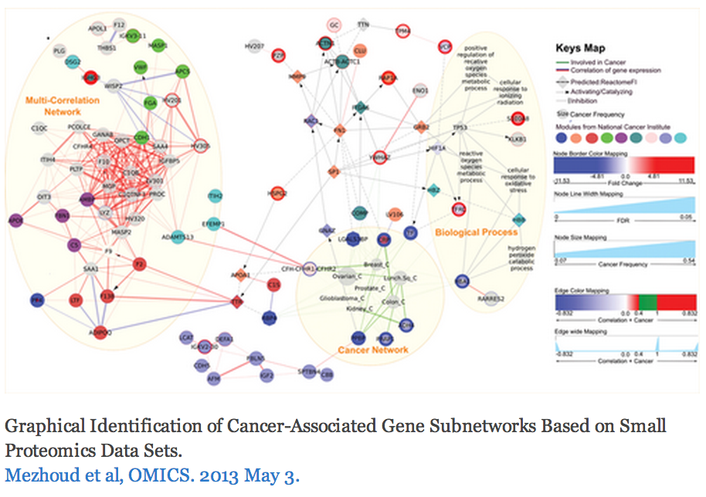
The Challenge
http://cytoscape-publications.tumblr.com/archive
Notes:
Some good examples
An example with perhaps too many visual properties
Cool cell illustration
Mapping brain regions (not proteins!)
Cytoscape is often just one part of an analysis pipeline

Slide 14
Biological Network Taxonomy
Pathways
Signaling, Metabolic, Regulatory, etc
Notes:
Signaling pathway: Interleukin-2
Metabolic pathway: Krebs (TCA) Cycle

Slide 15
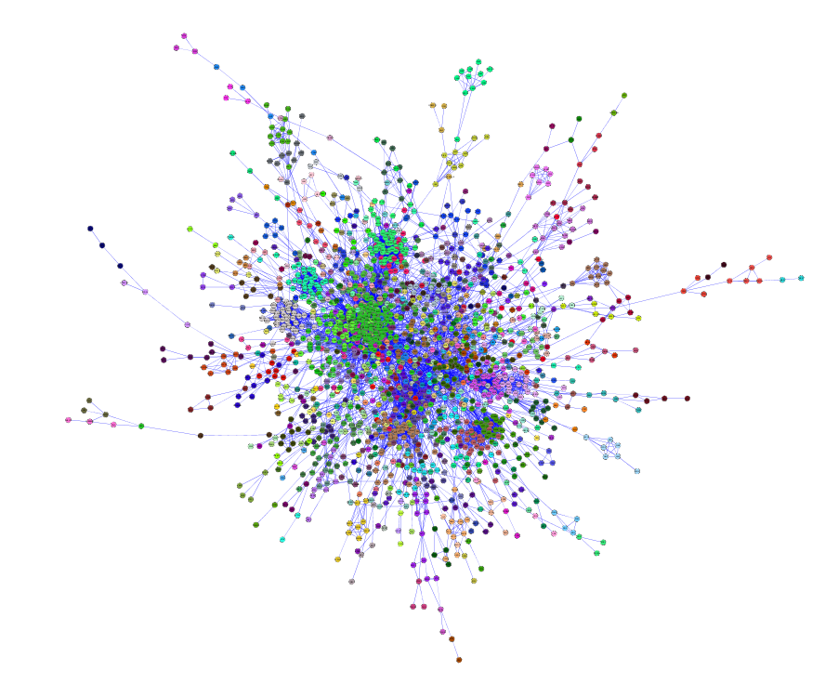
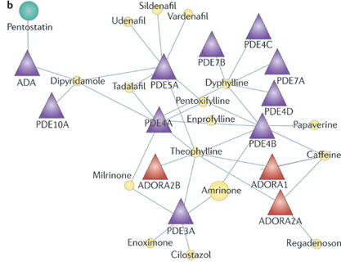
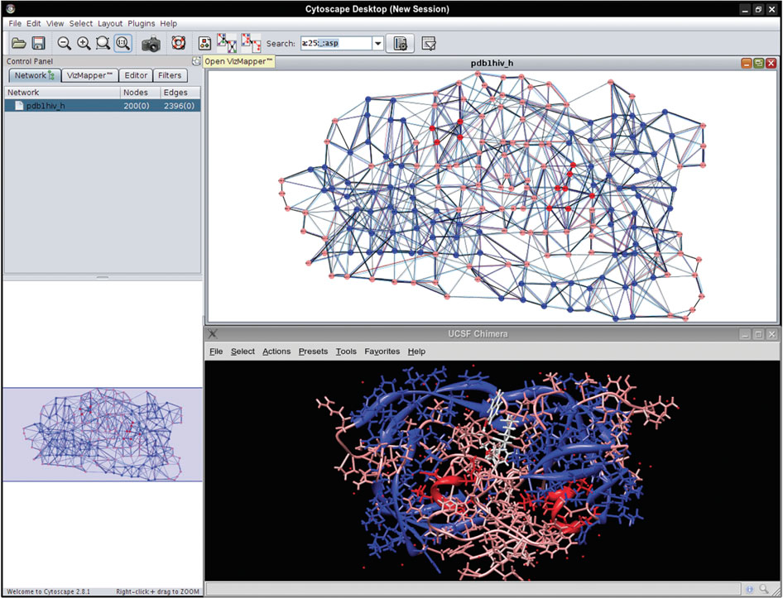
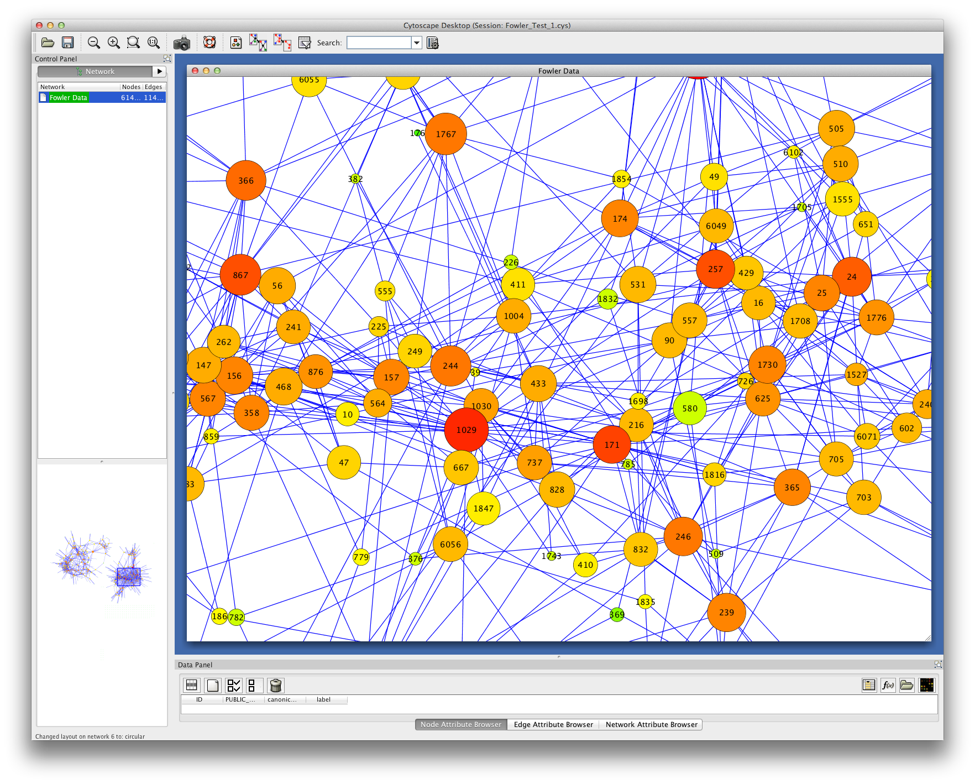
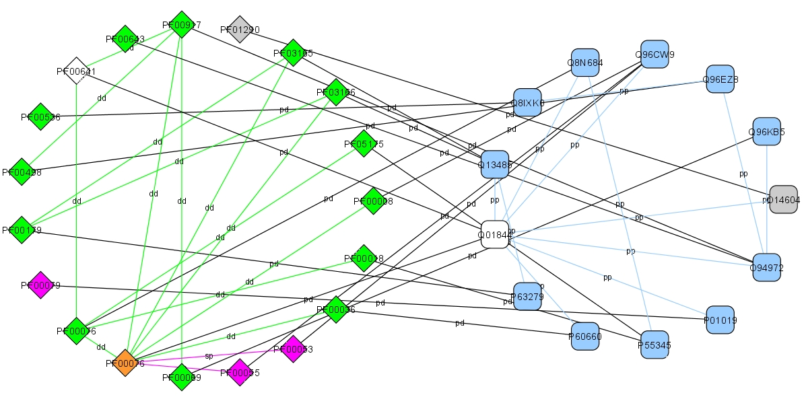
Biological Network Taxonomy
Interactions
Protein-Protein
Protein-Ligand
Domain-Domain
Others
Residue or atomic
Cell-cell
Epidemiology
Social networks

Slide 16
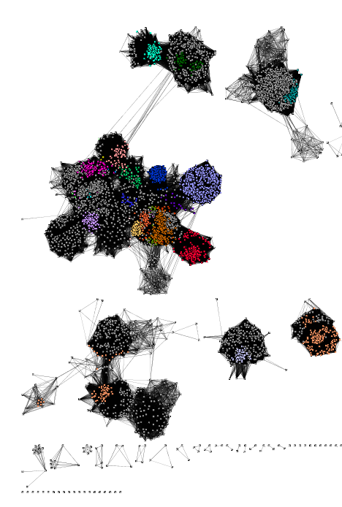
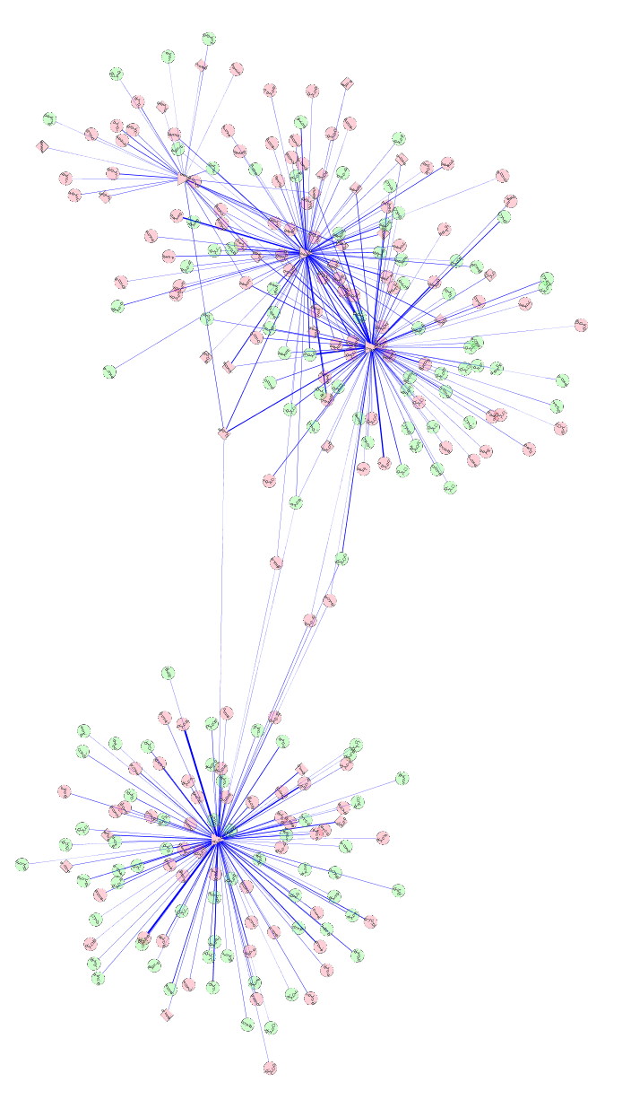
Biological Network Taxonomy
Similarity
Protein-Protein
Chemical similarity
Ligand similarity (SEA)
Others
Tag clouds
Topic maps

Slide 17
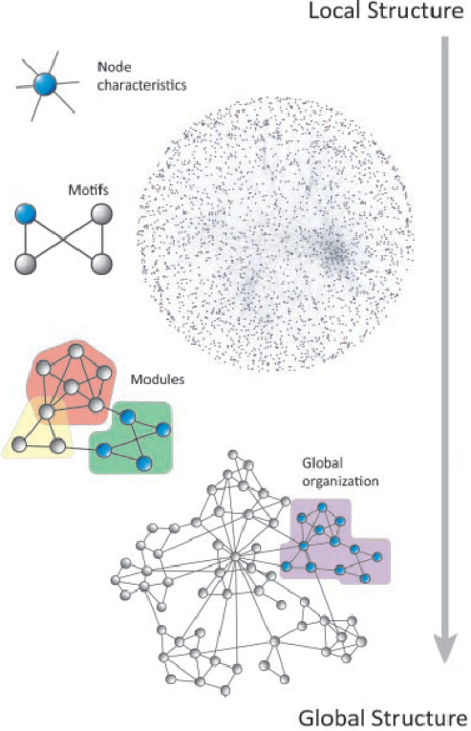
Analytical Approaches
The levels of organization of complex networks:
Node degree provides information about single nodes
Three or more nodes represent a motif
Larger groups of nodes are called modules or communities
Hierarchy describes how the various structural elements are combined

Slide 18
Analytical Approaches
Network topology statistics such as node degree, degree distribution, centralitiy, clustering coefficient, shortest paths, and robustness of the network to the random removal of single nodes are important network characteristics.
Motif analysis is the identification of small network patterns that are over-represented when compared with a randomized version of the same network. Regulatory elements are often composed of such motifs.
Modularity refers to the identification of sub-networks of interconnected nodes that might represent molecules physically or functionally linked that work coordinately to achieve a specific function.
Network alignment and comparison tools can identify similarities between networks and have been used to study evolutionary relationships between protein networks of organisms.

Slide 19
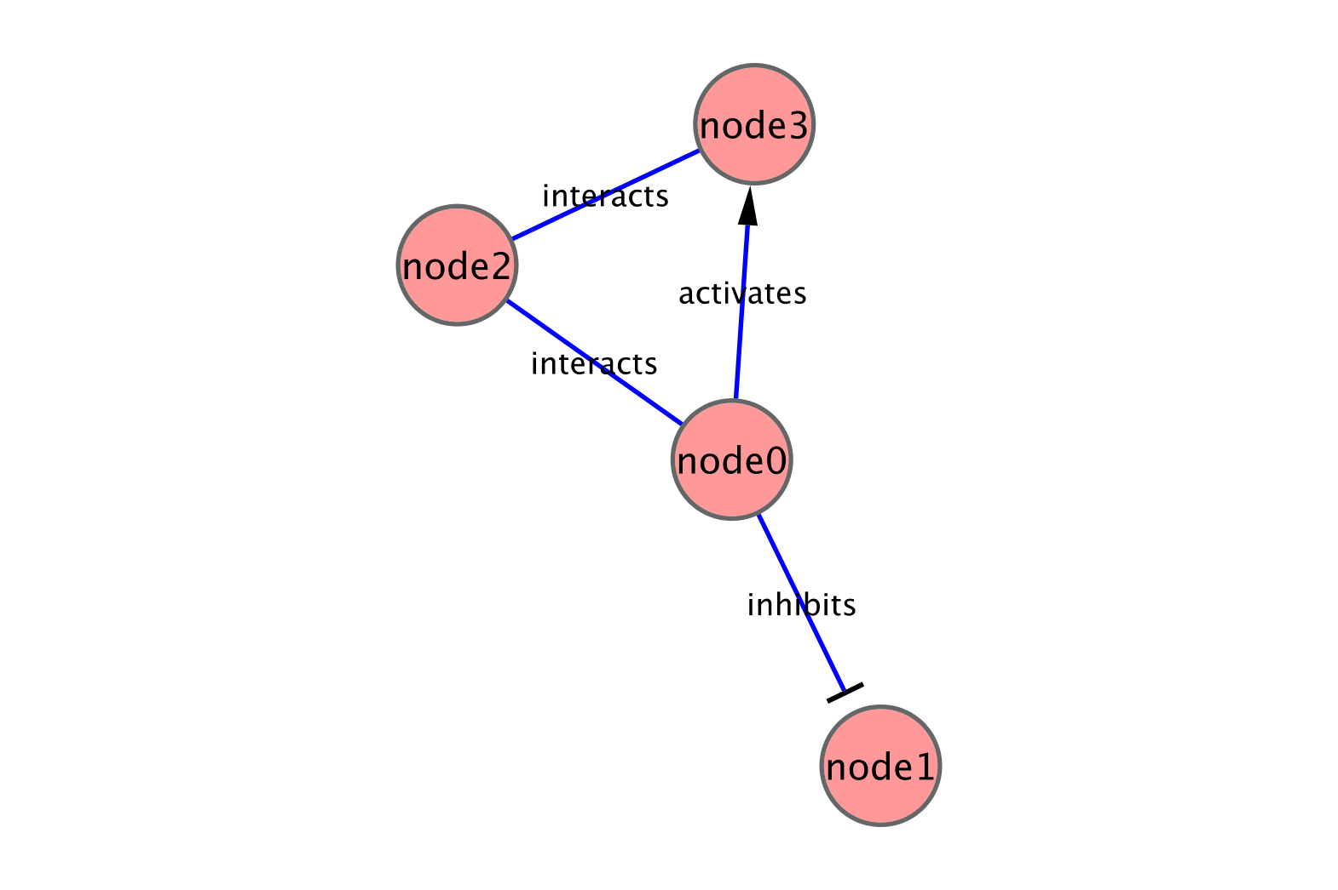
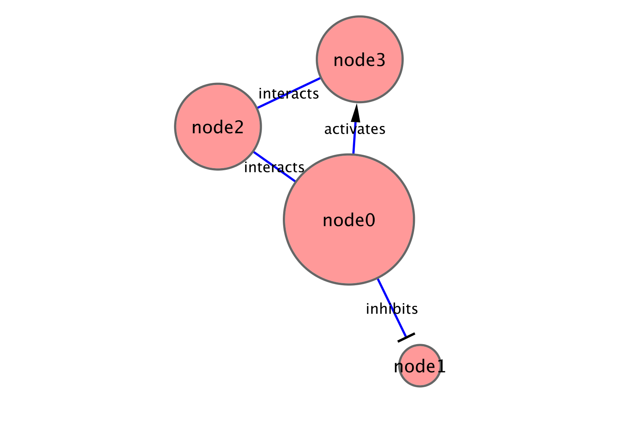
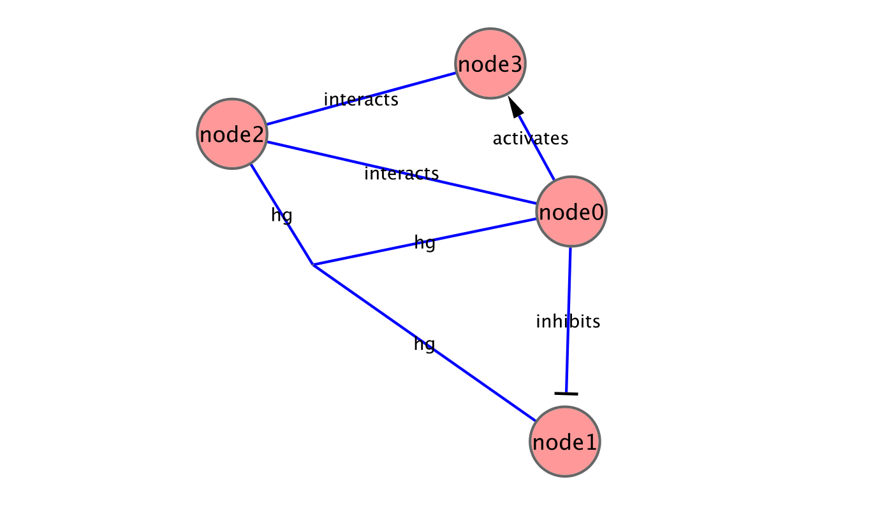
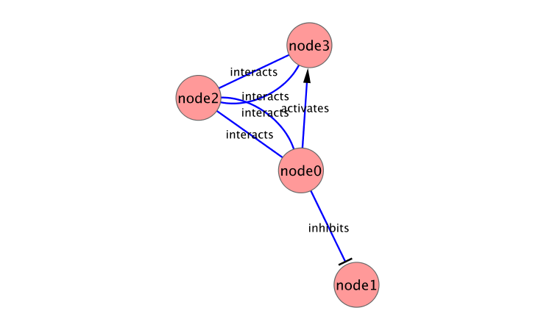
Analytical Approaches
Concepts
Graph/Network correspondence
Node/Vertex correspondence
Edge directedness
Usually a network property
Node degree
Multigraph
Allow multiple edges between nodes
Hypergraph
Allow edges to connect more than 2 nodes

Slide 20
Analytical Approaches
Network measures
Node degree
Indegree: # of edges for which this node is a target
Outdegree: # of edges for which this node is a source
Degree (undirected): # of edges incident to this node
Hub
node with an exceptionally high degree
2
2
3
1

Slide 21
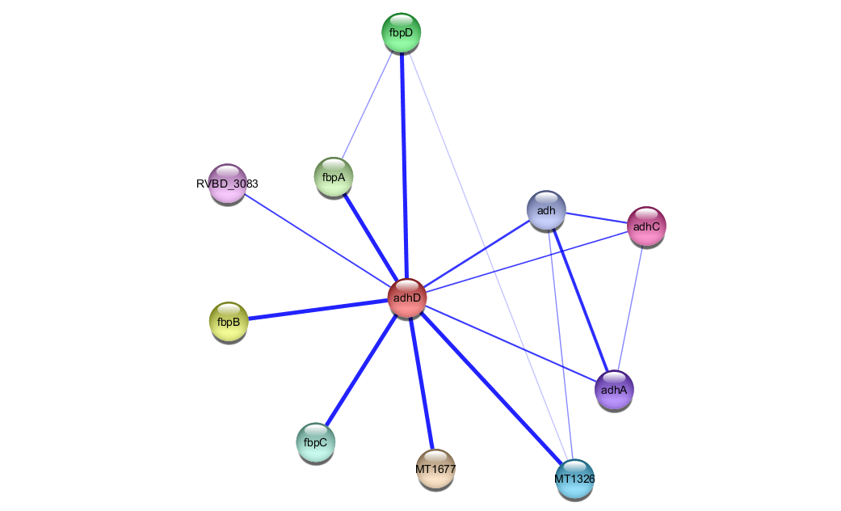
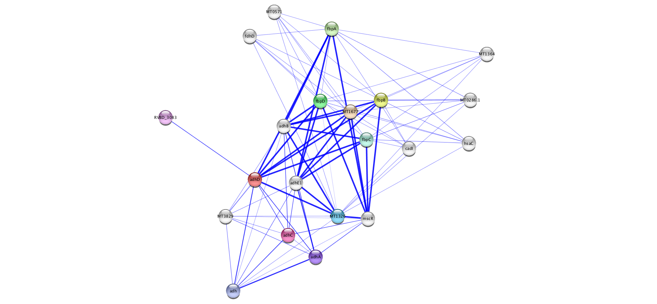
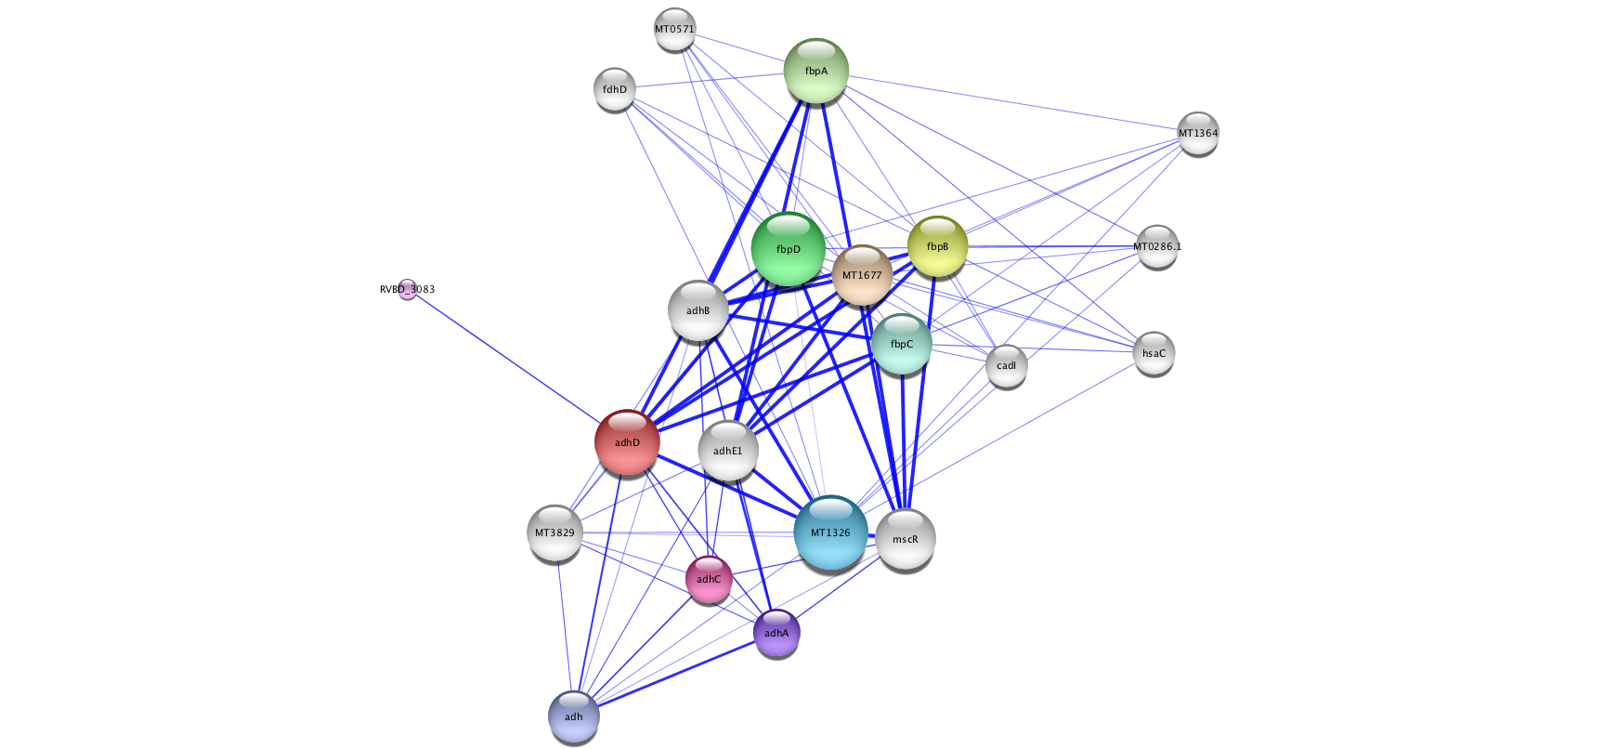
Analytical Approaches
Network measures
Node degree
Indegree: # of edges for which this node is a target
Outdegree: # of edges for which this node is a source
Degree (undirected): # of edges incident to this node
Hub
node with an exceptionally high degree
3
4
3
10
3
3

Slide 22
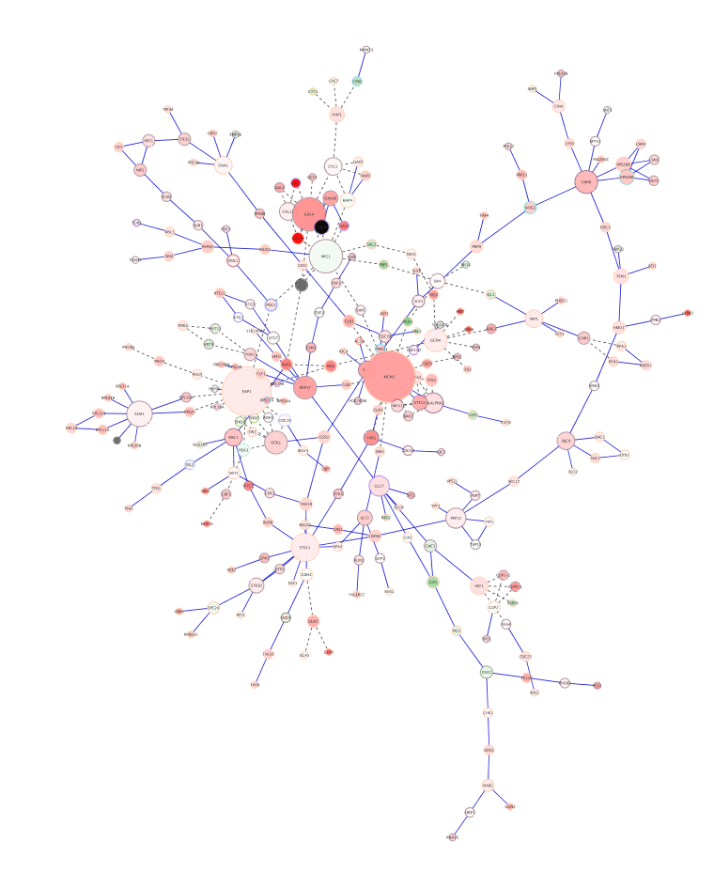
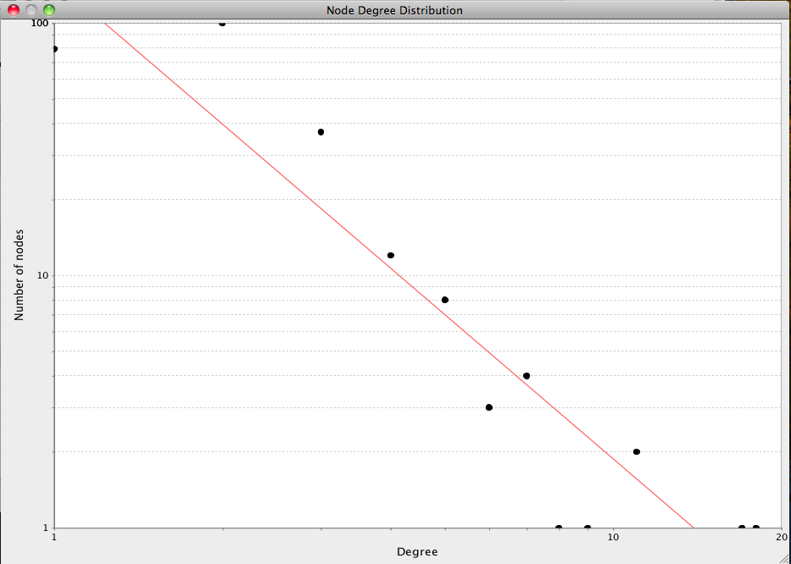
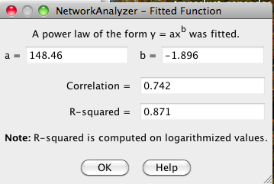
Analytical Approaches
Scale-free networks
Degree distribution follows power law:
P(k) ~ k^{-γ}, where γ is a constant.
Result is that there are distinctive “hubs” (essential proteins?)
Overall, though, network is resilient to perturbation
Biological (and social) networks tend to be scale-free

Slide 23
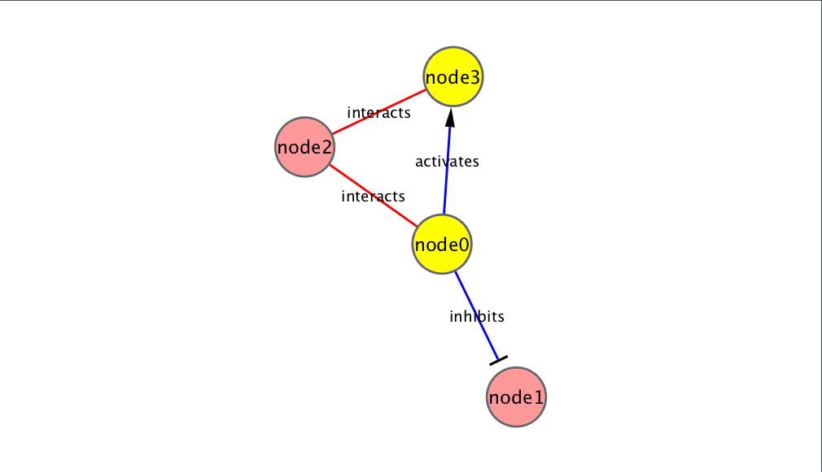
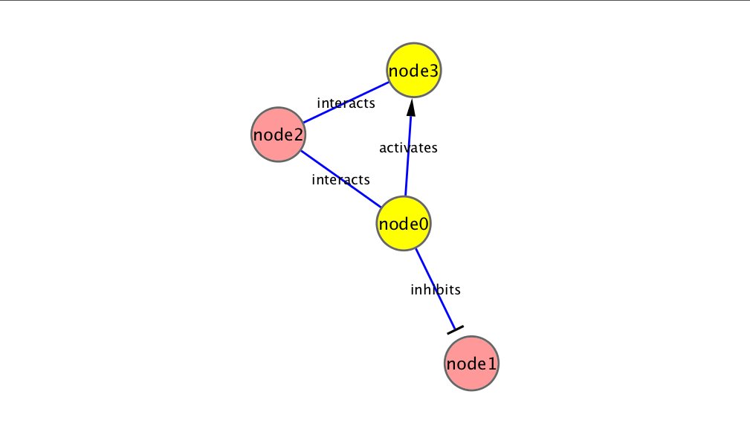
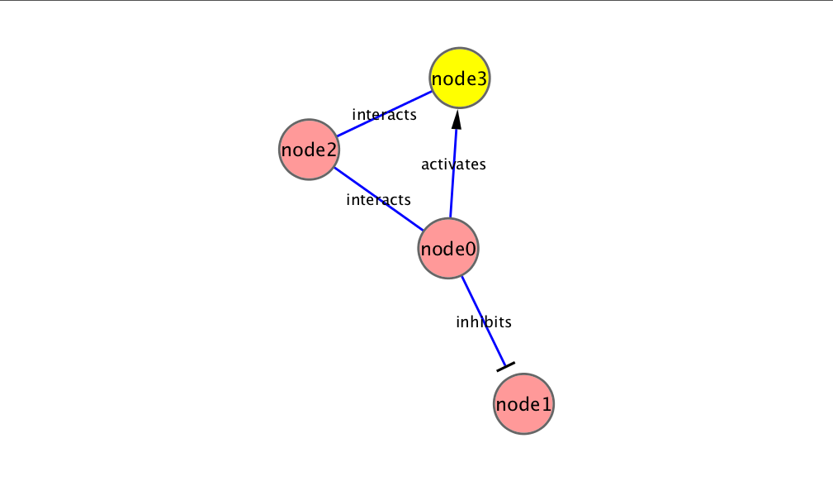

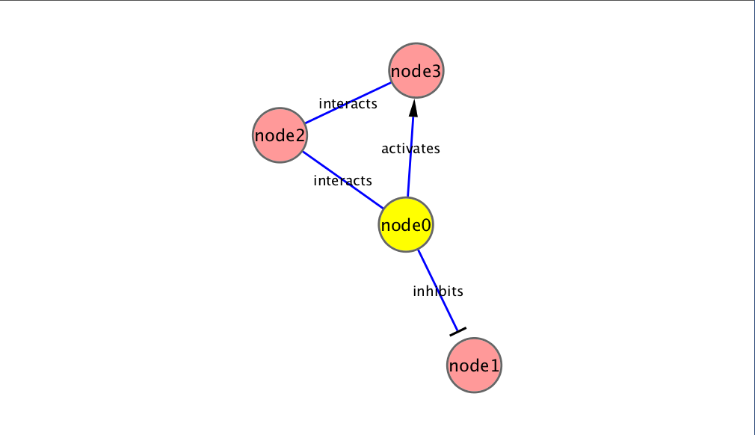
Analytical Approaches
Network measures
Shortest path length
Shortest traversal distance between two nodes
Can be weighted if edges have weights or hops if not
2
1

Slide 24
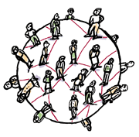
Analytical Approaches
Small-world networks
any two arbitrary nodes are connected by a small number of intermediate edges
the network has an average shortest path length much smaller than the number of nodes in the network (Watts, Nature, 1998).
Interaction networks have been shown to be small-world networks (Barabási, Nature Reviews in Genetics, 2004)

Slide 25
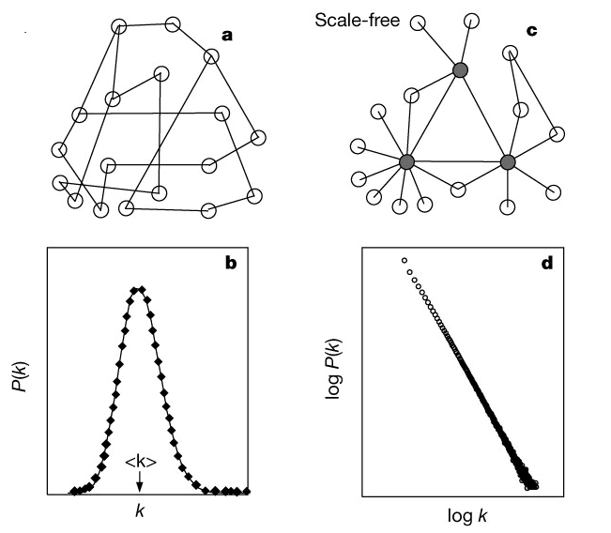
Analytical Approaches
Random networks
homogeneous, nodes have similar degrees, and not robust to arbitrary node failure
Algorithms exist to create random networks
Flat random network: Erdos-Renyi
Scale-free: Barabasi-Albert
Small-world (high clustering): Watts-Strogatz
Useful to compare your network vs. a random network

Slide 26
Analytical Approaches
Network measures
Clustering coefficient
Measures how close the neighbors of a node are to being a clique (fully connected group)
# of edges connecting a node’s neighbors/the node’s degree
1.0
0.5
0.3
0

Slide 27
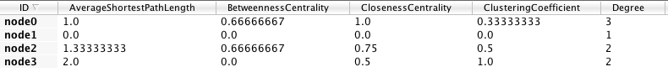
Analytical Approaches
Centrality - measures of node importance
Degree centrality (find hubs)
Degree of this node / (# of nodes – 1)
Betweenness centrality (bottleneck)
The average number of shortest paths that go through this node / (# of pairs)
Closeness centrality
The sum of all shortest paths between this node and all other nodes / (# of nodes – 1)

Slide 28
Analytical Approaches
Network Analyzer Demo…

Slide 29
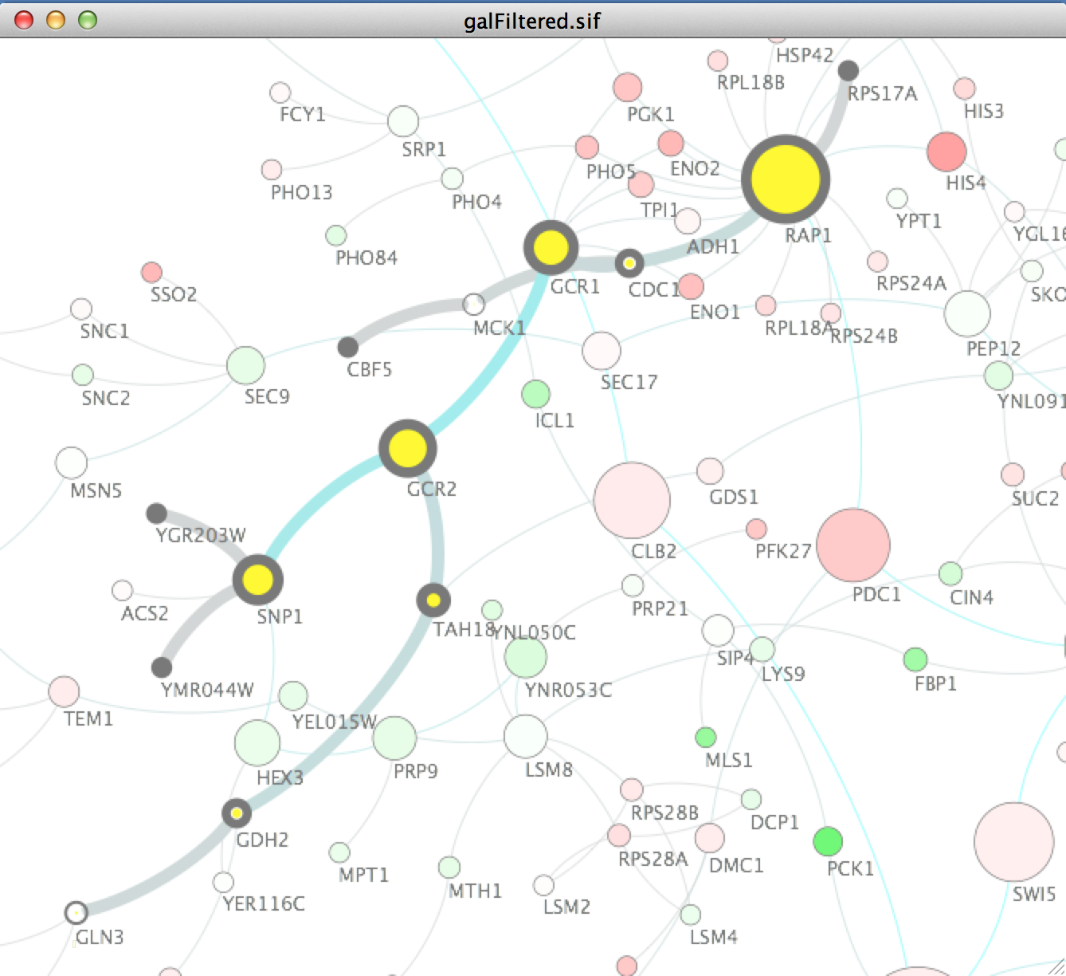
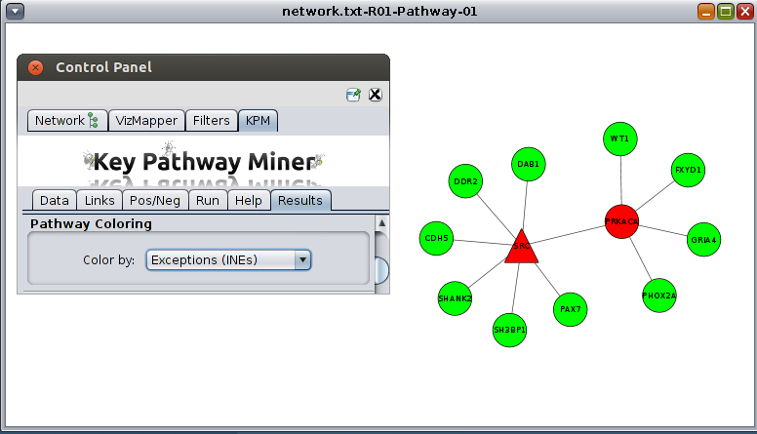
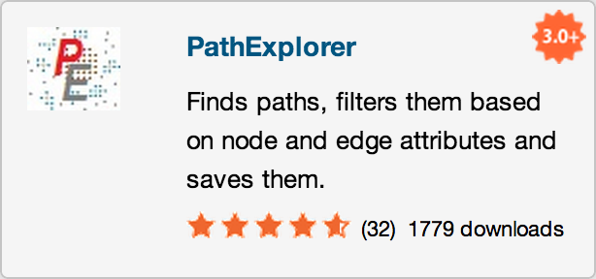
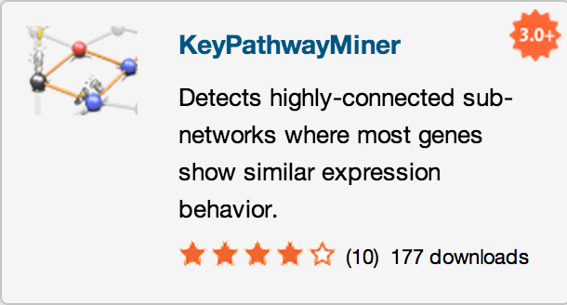
Analytical Approaches
Motif finding
Search directed networks for network motifs (feed-forward loops, feedback loops, etc.)

Slide 30





Analytical Approaches
Overrepresentation analysis
Find terms (GO) that are statistically overrepresented in a network
Not really a network analysis technique
Very useful for visualization
Notes:
Note: all Cytoscape ORA tools provide a network visualization of terms and a ranked table with statistics

Slide 31






Analytical Approaches
Clustering (find hubs, complexes)
Goal: group related items together
Clustering types:
Hierarchical clustering
Divide network into pair-wise hierarchy
K-Means clustering
Divide network into k groups
MCL
Uses a flow simulation to find groups
Community Clustering
Maximize intra-cluster edges vs. inter-cluster edges

Slide 32
Visualization of Biological Networks
Data Mapping
Layouts
Animation

Slide 33





Depiction
Various ways to depict biological networks:
Node-Link (graph) representation
Partitioned Node-Link representation
Matrix representation
Can be useful for very dense networks
Can also map information into cells of matrix
e.g. degree, color scale (heat map)
Hierarchical reduction to 1D
Orthogonal 1D representation of nodes/edges
Notes:
Last two:
- NetGestalt (used to align data in fashion of genome browsers)
- BioFrabric (used to organize/explore massive hairballs)

Slide 34








Data Mapping
Mapping of data values associated with graph elements onto graph visuals
Visual attributes
Node fill color, border color, border width, size, shape, opacity, label
Edge type, color, width, ending type, ending size, ending color
Mapping types
Passthrough (labels)
Continuous (numeric values)
Discrete (categories)

Slide 35
Data Mapping
Avoid cluttering your visualization with too much data
Map the data you are specifically interested in to call out meaningful differences
Mapping too much data to visual attributes may just confuse the viewer
Can always create multiple networks and map different values

Slide 36






Layouts
Layouts determine the location of nodes and (sometimes) the paths of edges
Types:
Simple
Grid
Partitions
Hierarchical
layout data as a tree or hierarchy
Works best when there are no loops
Circular (Radial)
arrange nodes around a circle
could use node attributes to govern position
e.g. degree sorted

Slide 37


Layouts
Types:
Force-Directed
simulate edges as springs
may be weighted or unweighted
Combining layouts
Use a general layout (force directed) for the entire graph, but use hierarchical or radial to focus on a particular portion
Multi-layer layouts
Partition graph, layout each partition then layout partitions
Many, many others

Slide 38
Layouts
Use layouts to convey the relationships between the nodes
Layout algorithms may need to be “tuned” to fit your network
Layouts→Settings… menu
Lots of parameters to change layout algorithm behavior
Can also consider laying out portions of your network

Slide 39



Animation
Animation is useful to show changes in a network:
Over a time series
Over different conditions
Between species

Slide 40
Introduction to Cytoscape
Overview
Core Concepts
Networks and Tables
Visual Properties
Cytoscape Apps
Working with Data
Loading networks from files and online databases
Loading data tables from CSV or Excel files
The Table Panel
Notes:
EDIT: according to schedule

Slide 41

Cytoscape
cytoscape.org
Visualization
Integration
Analysis

Slide 42




Cytoscape
Open source
Cross platform
Consortium
University of Toronto
Notes:
NOTE: Pre-acknowledgements slide

Slide 43


Core Concepts
Networks and Tables
Networks
e.g., PPIs or pathways
Tables
e.g., data or annotations
Notes:
Notes: it is a Cytoscape goal that both the graph model and the data are free from Biological semantics

Slide 44

Core Concepts
Networks and Tables
Networks
Tables
Visual Styles

Slide 45



Core Concepts
Cytoscape Apps!
http://apps.cytoscape.org
Notes:
Screenshots: App Store front page, example app, and wall of apps
Note: mention increasing number of apps (and ports to 3.x)
Alternative: visit App Store live
45

Slide 46
Cytoscape
Common use cases
Visualizing:
Protein-protein interactions
Pathways
Integrating:
Expression profiles
Other state data
Analyzing:
Network properties
Data mapped onto network

Slide 47



Loading Networks
Use import network from file
Excel file
Comma or tab delimited text

Slide 48



Loading Networks
Use import network from file
Excel file
Comma or tab delimited text
But what if I don’t have any network files?!
Notes:
Welcome!
- web services: a couple provided by default (more in App Store)
- preset networks from BioGRID per species (mouse over for details)

Slide 49

Loading Tables
Nodes and edges can have data associated with them
Gene expression data
Mass spectrometry data
Protein structure information
Gene Ontology terms, etc.
Cytoscape supports multiple data types: Numbers, Text, Logical, Lists...

Slide 50




Loading Tables
Use import table from file
Excel file
Comma or tab delimited text

Slide 51




Visual Style Manager
Click on Visual Styles tab
Default, Mapping, Bypass
Notes:
New interface!
- def, map, byp
- example continuous mapping panel
- menu of provided visual styles

Slide 52



Selection Filters
Click on Select tab
Select nodes and edges based on a node or edge columns
Nodes with degree > 10 or annotated with a particular GO term
Dynamic filtering for numerical values
Build complex filters using AND, OR, NOT relations
Define topological filters (considers properties of near-by nodes)

Slide 53
Saving and Exporting
Sessions save pretty much everything: Networks, Properties, Visual styles, Screen sizes
Export networks in different formats: SIF, GML, XGMML, BioPAX, PSI-MI 1 & 2.5
Publication quality graphics in several formats: PDF, EPS, SVG, PNG, JPEG, and BMP

Slide 54
Getting Help
cytoscape-helpdesk@googlegroups.com

Slide 55
Tips & Tricks
Network Collections
Each collection has a “root” network
Changing the attribute for a node in one network will also change that attribute for a node with the same SUID in all other networks within the collection
You can clone a network into a new collection to “decouple” it and start a new root

Slide 56
Tips & Tricks
Network views
When you open a large network, you will not get a view by default
To improve interactive performance, Cytoscape has the concept of “Levels of Detail”
Some visual attributes will only be apparent when you zoom in
The level of detail for various attributes can be changed in the preferences
To see what things will look like at full detail:
View→Show Graphics Details

Slide 57
Tips & Tricks
Sessions
Sessions save pretty much everything:
Networks
Properties
Visual styles
Screen sizes
Saving a session on a large screen may require some resizing when opened on your laptop

Slide 58
Tips & Tricks
Task monitor
Current task displayed in status bar (lower left)
Icon opens complete task history
Memory
Current status (lower right)
Toggle open for details and “Free Unused Memory” button
Notes:
Note: these used to be major issues in 2.x

Slide 59
Tips & Tricks
CytoscapeConfiguration directory
Your defaults and any apps downloaded from the App Store will go here
App Manager
This is where you search/install/update/uninstall apps
You now have the option of disabling vs. uninstalling…
Can also install and update apps directly from the App Store website, if you have Cytoscape 3 up and running

Slide 60
Cytoscape: Platform
Cytoscape as a platform
App architecture
http://apps.cytoscape.org
Use cases
Expression data analysis
Protein complexes
Agilent literature search

Slide 61
Hands-on Tutorial
Introduction to Cytoscape:
Networks, Data, Styles, Layouts and App Manager
http://tutorials.cytoscape.org

Slide 62
Hands-on Tutorial
App Tutorials:
http://tutorials.cytoscape.org
http://rbvi.ucsf.edu/cytoscape/structureViz2/tutorial.html
http://rinalyzer.de/tutorials.php
Notes:
TODO: Update

Slide 63
Examples/Demos
clusterMaker
Clustering and cluster visualizations
Agilent LitSearch Tool
Extracting networks from abstracts
WikiPathways
Search and load pathway diagrams
Notes:
clusterMaker:
- simple: galFiltered -> BiNGO
- complex: collins PPI
litSearch:
- CDC25, human, cancer
WikiPathways
- human: TCA, Statin or 5-FU

Slide 64


Expression Data Analysis
Load galFiltered.cys
Explore the expression fold changes: gal1RGexp, gal4RGexp, and gal80Rexp. The network is colored by gal4RGexp values.
To explore the expression profile for these three deletions, we can use clusterMaker to do a hierarchical cluster
Apps→clusterMaker→Hierarchical
Choose the attributes we’re interested in (node.gal1RGexp, node.gal4RGexp, node.gal80Rexp)
Choose the type of clustering (pairwise average-linkage, Euclidean distance)
Click “Show TreeView when complete”
Click OK
Notes:
The example file, galFiltered.cys is included with all Cytoscape releases. It is taken from Ideker, et.al. 2001, although it has gained significantly more annotations over the years. It shows a protein-protein interaction network that focuses on the galactose (gal) utilization in the yeast Saccharomyces cerevisiae. The network was perturbed by gene deletion of the major GAL genes, then the cells were grown in the presence and absence of galactose.

Slide 65


Expression Data Analysis
After the clustering is complete (very fast) the Tree View will be shown
If the colors are too dark, they can be adjusted in the Settings… dialog.
Select the dendrogram branch at the top, as shown
Note that this will also select those proteins in the network view

Slide 66


Expression Data Analysis
Now we can see if these genes show any GO overrepresentation
Start BiNGO
Apps→BiNGO
Give the clusters a name (e.g. cluster1)
Click on Start BiNGO to process the data
The results include a table and a network of GO associations
In this case the top term is “galactose catabolic process via UDP-galactose,” which makes good sense

Slide 67






Expression Data Analysis
Active modules
The jActiveModules app identifies clusters that show differential expression over user-specified conditions or time-points
Go to the jActiveModules tab in the Control Panel
Select the galFiltered.sif interaction network
Select the attributes that contain the gene expression p-values: gal1RSig, gal4RSig, gal80RSig
Click Search
Explore the resulting networks
Overview network shows the overlap between the active modules
Color nodes according to expression to see the significant changes
Apply BiNGO on one of the active modules

Slide 68

Protein Complexes
Load collinsPlus.cys
Three networks, but only one view
combined_scores_good.txt: Combined MS/TAP Yeast PPI network from Collins, et. al.
DNA and Tran 07-21-06b.csv: Yeast EMAP
RNAPuberNov2+Meg6c.csv: Yeast EMAP

Slide 69


Protein Complexes
Load collinsPlus.cys
Three networks, but only one view
combined_scores_good.txt: Combined MS/TAP Yeast PPI network from Collins, et. al.
DNA and Tran 07-21-06b.csv: Yeast EMAP
RNAPuberNov2+Meg6c.csv: Yeast EMAP
Find MCL clusters in the PPI network
Apps→clusterMaker→MCL cluster
Density Parameter: 1.8
Array source: PE Score
Cutoff value to minimum (1.85)
Select “Create new clustered network” and “Restore inter-cluster edges after layout”

Slide 70

Protein Complexes
Now that we have PPI clusters, we can explore some EMAP data
Select the “DNA and Tran…” network
Now perform a hierarchical cluster
Apps→clusterMaker→Hierarchical Cluster
And select “DNA Strength” from Edge
Click on Visualize Clusters to bring up the TreeView

Slide 71



Protein Complexes
Now that we have PPI clusters, we can explore some EMAP data
Select the “DNA and Tran…” network
Now perform a hierarchical cluster
Apps→Cluster→Hierarchical Cluster
Click on Visualize Clusters to bring up the TreeView
Select your PPI clustered network in Cytoscape
Search for GIM5 and select the entire cluster
Note how the proteins in TreeView highlight
Note that BUD27 doesn’t cluster very well in EMAP
Deselect BUD27 edge

Slide 72





From Networks to Structures
Cytoscape apps: structureViz2, RINalyzer, cddApp, chemViz2
Load pte.xgmml
Protein similarity network of the Phosphotriesterases family
Open the structure 1EZ2 in Chimera and explore it
Select nodes and invoke the node’s context menu Apps→ structureViz→ Open Structures for Node(s)
Use the Molecular Structure Navigator to enhance the display
Create a residue interaction network
Select residues in the structure and use the top menu bar Chimera→ Residue network generation menu

Slide 73
Cytoscape Roadmap

Slide 74
Cytoscape 3.3
Release target: November 2015
Major features:
Compound Node Visualization
“Core” Apps
New table loader
Other features:
Visual redesign
OpenCL-based layout
Marquee edges
Merging of REST into CyREST
Core-wide user logging
Java 8 required

Slide 75




Compound Nodes
Cytoscape model supports network hierarchy
No easy way to visualize it
Compound nodes:
Nodes that contain nodes
Interior nodes can be moved and compound node resizes accordingly
Implemented using group mechanism
Expand/collapse still works

Slide 76
Core Apps
Remove “app-like” functionality from Cytoscape core
NetworkAnalyzer
Layouts
REST interface
Recreate them as apps
Install a version as part of Cytoscape install
Can release newer versions via App Store

Slide 77

New Table Loader
Loading AP/MS data in Cytoscape 3.2:
Load network and edge data from Excel spreadsheet
Load bait data from the same Excel spreadsheet
Load prey data from the same Excel spreadsheet
Three different loads to get the same data
Column types guessed by Cytoscape often wrong

Slide 78
Cytoscape 3.4
Release target: May-June 2016
Major features:
Headless version
Jobs interface
Long running tasks
Web services integration
Themes
Groups of apps for particular purposes
Relative annotations
Other features:
Redesigned network panel (tree structure)
Consistent preferences UI
JSON representation for all Cytoscape objects

Slide 79
Questions?
scooter@cgl.ucsf.edu
cytoscape-helpdesk@googlegroups.com

